Slide 1
Qt Graphical User Interface
Always Look on the PySide of Life ☺
Notes:
sudo apt install qt5-default
sudo pip3 install PySide2
1.5 min

Slide 2
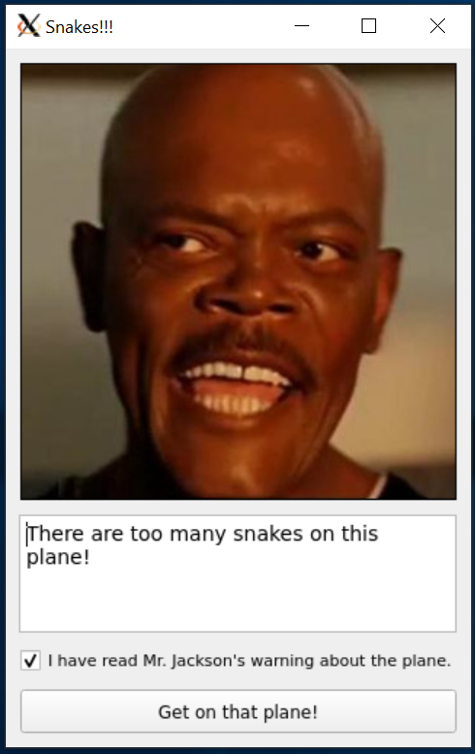
Graphical User Interfaces
Graphical User Interfaces (GUIs) are often widget-based.
Elements of a GUI form – buttons, sliders, text boxes
Hierarchical in nature (window → layout → buttons)
Can be built using designer tool / suite (code or data)
Provide users with affordances for decision making
Connect widget actions to program routines / behavior
Source of insufferable “Visual” titles (Visual Basic, etc)
Notes:
6.5 min

Slide 3
So… What is Qt / PyQt / PySide(2)?
Qt is popular as a cross-platform, cross-language toolkit.
Qt’s claim to fame is the GUI tools, but it also others (e.g., threading)
PyQt is not “official” Qt – it’s from a small British company
The “PySide” project is officially “Qt for Python” (recently, PySide2)
Older stuff often uses PyQt, but newer tools / versions use PySide
PyQt also has more restrictive licensing (see: $$$)
The built-in toolkit is TkInter – it is nice but limited, so we’ll use Qt.
Notes:
3.5 min

Slide 4
Qt Application Anatomy
Some core classes are important for building Qt-based programs.
QObject – Qt base class
to interact with Qt objects, extend this (event handlers, etc)
QApplication – “driver” for a Qt-form-based program
Can also access elements for desktop system in some cases (e.g., KDE)
QWidget – widgets in a GUI form are derived from this
You can derive from this, but it will make using a designer harder
QThread – used in some multithreaded Qt-specific applications
Notes:
4.5 min

Slide 5
Programmed GUI Forms
Forms can be developed manually via object instantiation.
from PySide2.QtWidgets import *
from PySide2.QtGui import QFont, QPixmap
import sys
# Create the application – must be first!
app = QApplication(sys.argv)
# Create and set up the main window.
window = QMainWindow()
window.setGeometry(0, 0, 320, 480)
window.setWindowTitle("Snakes!!!")
# Create and set up the window’s widgets.
label = QLabel(window)
label.setGeometry(10, 10, 300, 300)
label.setPixmap(QPixmap("snakes.jpg"))
textbox = QTextEdit(window)
textbox.setGeometry(10, 320, 300, 80)
textbox.setText("There are too many snakes on this plane!")
checkbox = QCheckBox(window)
checkbox.setGeometry(10, 410, 300, 20)
checkbox.setChecked(True)
checkbox.setFont(QFont("Arial", 8))
checkbox.setText("I have read Mr. Jackson's warning about the plane.")
button = QPushButton(window)
button.setGeometry(10, 440, 300, 30)
button.setText("Get on that plane!")
button.clicked.connect(lambda: window.close())
window.show()
sys.exit(app.exec_())
Notes:
14.5 min

Slide 6
Data-Driven GUI Forms
Qt (and many other toolkits) allow GUI forms to be read from data files.
<?xml version="1.0" encoding="UTF-8"?>
<ui version="4.0">
<class>MainWindow</class>
<widget class="QMainWindow" name="MainWindow">
<property name="geometry">
…
</property>
<widget class="QWidget" name="centralwidget">
<widget class="QLabel" name="label">
<property name="pixmap">
<pixmap>snakes.jpg</pixmap>
</property>
…
</widget>
…
</widget>
</widget>
</ui>
from PySide2 import QtUiTools
from PySide2 import QtCore
from PySide2.QtWidgets import QApplication
from PySide2.QtWidgets import QPushButton
import sys
app = QApplication(sys.argv)
ui_file = PySide2.QtCore.QFile("jackson.ui")
ui_file.open(PySide2.QtCore.QFile.ReadOnly)
loader = PySide2.QtUiTools.QUiLoader()
window = loader.load(ui_file)
ui_file.close()
button = window.findChild(QPushButton, "button")
button.clicked.connect(lambda: window.close())
window.show()
sys.exit(app.exec_())
Many designer programs (e.g., Qt Creator) can generate code or data files.
Notes:
8 min

Slide 7
The Curse of Responsiveness
Interactive applications need to prioritize response, which has a cost.
We can’t do intense processing on the main process / thread (lock-up)
We can’t edit any widget memory from another thread (Qt monitors this)
So how do we do multithreading / multiprocessing & share memory?!
Program must keep shared memory outside of widgets and use handlers.
Notes:
5 min

